Slide 1
CS-Streaming
Uncovering the secrets of Success

Slide 2





Background
Netflix is an American subscription on-demand streaming service, employing 12,800 people. It is the most subscribed on-demand streaming service.
Originally launched as a DVD-by-mail service in 1997, it transitioned into streaming from 2007.
In the US, half of its library is now Netflix original productions.
Netflix now operates in almost every country, with over 238 million paid memberships.
Netflix was the first streaming service to enter the Motion Picture Association of America and it won its first Oscar in 2018 for documentary Icarus.
Netflix stock opened on NASDAQ in 2002 and the company is now worth an estimated $197 billion.
Sources: https://en.wikipedia.org/wiki/Netflix;
netflix market summary

Slide 3
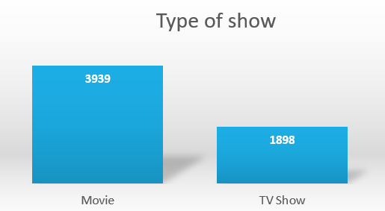

What Netflix offers
Two-thirds
of Netflix content is movies

Slide 4
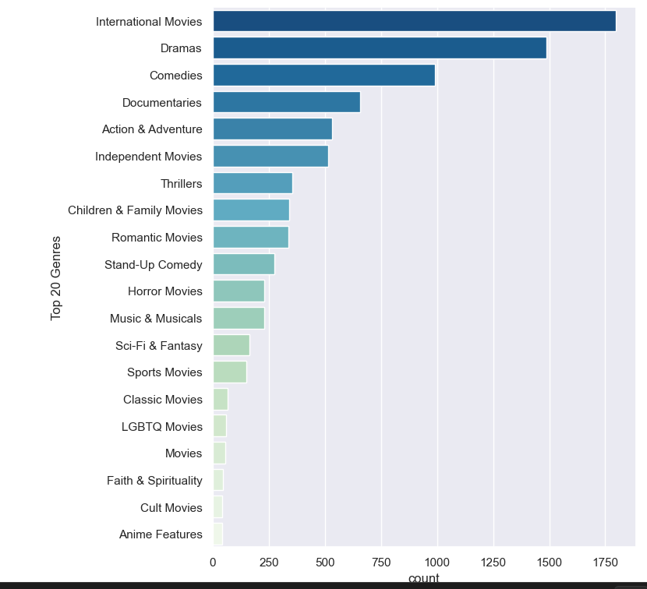
Global entertainment
International movies are a key factor to success, making up the majority of content on Netflix, followed by dramas and comedies.

Slide 5
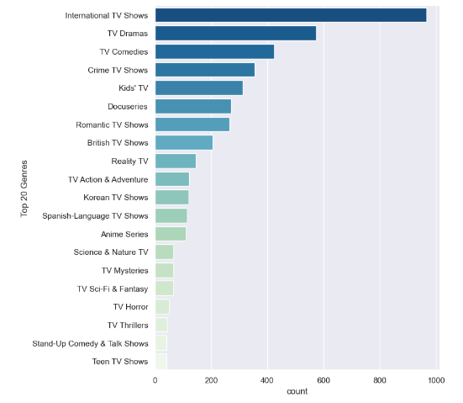
Global entertainment
It's a similar picture for TV, here international content is a major factor. Audiences love homegrown shows but in a global market content crosses borders. Recent hits include Squid Game (S Korea) and Money Heist (Spain).
https://collider.com/netflix-most-watched-non-english-shows/#39-money-heist-39---part-4

Slide 6
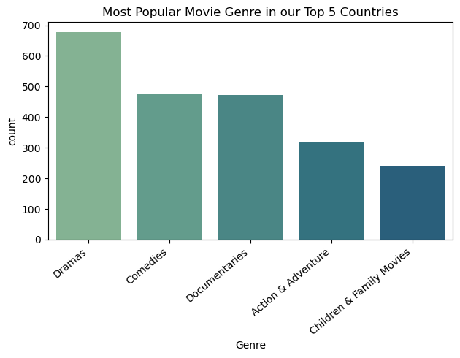
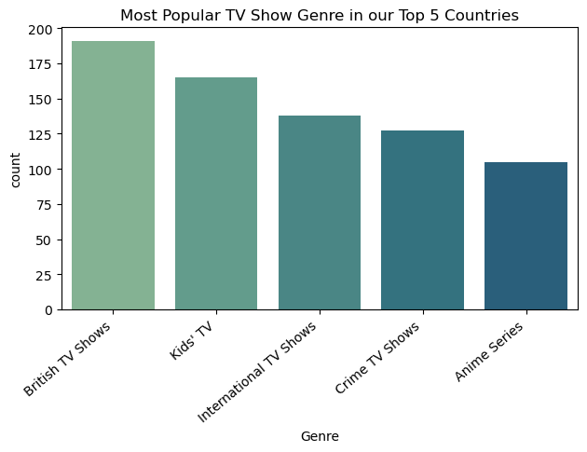
Market focus – a closer look
The majority of content comes from the US, India, UK, Canada and Japan.
The focus for feature-length content is on drama, comedies and docuseries.
Whereas for TV we can see the impact of UK output and where family content should be focused.

Slide 7
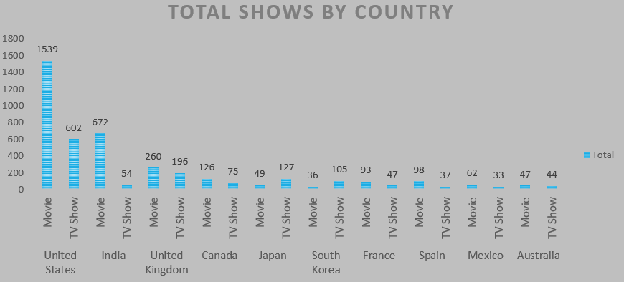
Content by country of production

Slide 8
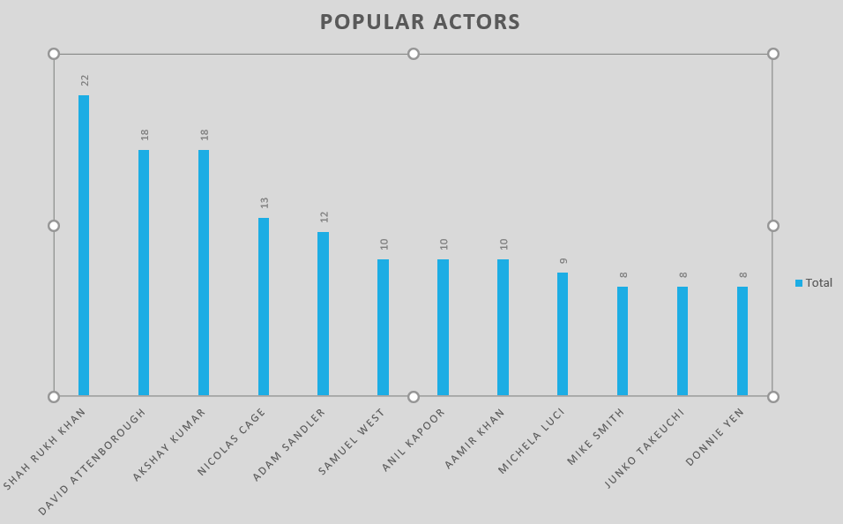

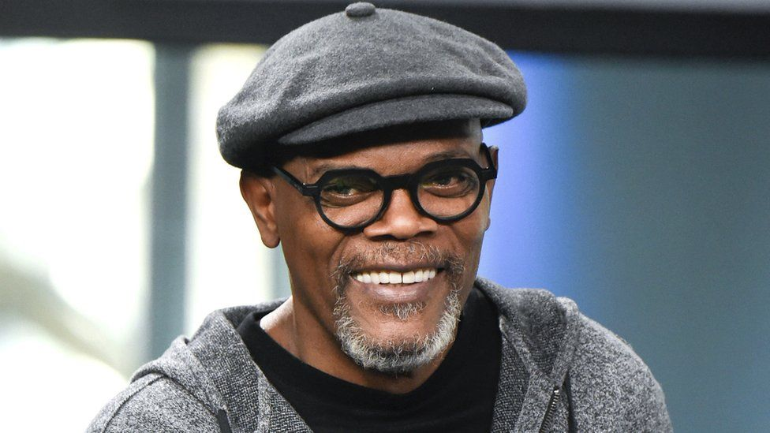


Looking outside of Hollywood
The highest grossing actors can all be found on Netflix, however they don't feature highly.
Look outside Hollywood to build your platform.
Bollywood films and documentaries are great ways to bring in audiences.
https://en.wikipedia.org/wiki/List_of_highest-grossing_actors

Slide 9
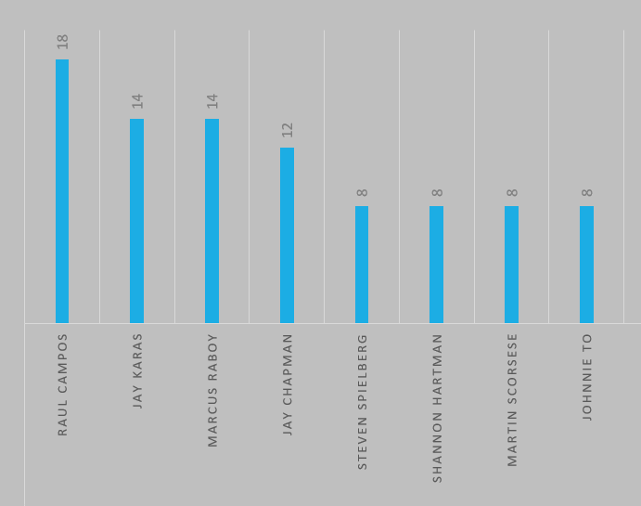
Building content
Most popular directors
Looking at the most prolific directors on the platform, the most content is for stand-up comedy.
Stand-up has the following advantages:
Cheaper to produce than films or series
Comedians regularly tour meaning lots of opportunities to film
This also means that new material is available regularly
Highest grossing director Steven Spielberg is well represented on Netflix with some of his most successful films available:
The Indiana Jones films
Schindler's List
The Adventures of Tintin
War Horse
https://en.wikipedia.org/wiki/List_of_highest-grossing_film_directors

Slide 10
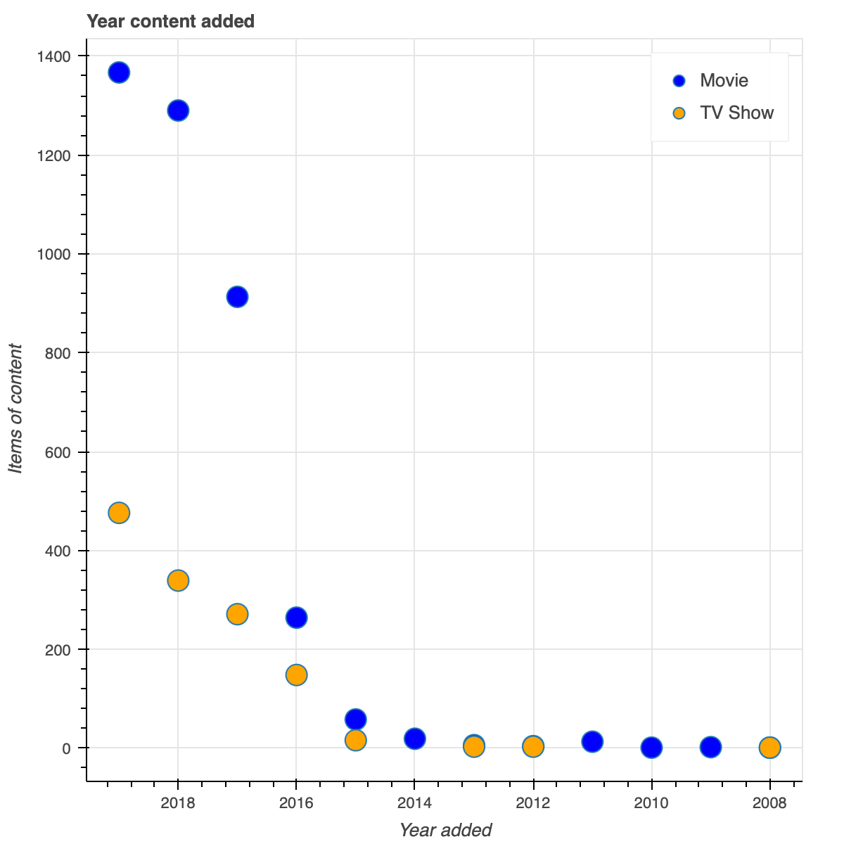
Keeping the customer entertained
Fresh content is key to keeping the audience's attention, with few movies or TV shows staying on Netflix longer than
2 years

Slide 11
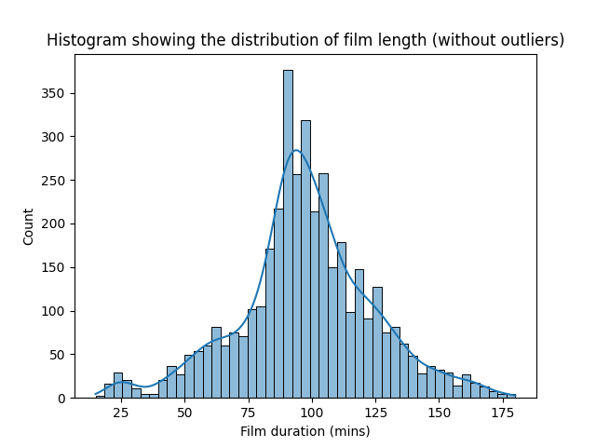
Keeping their attention
The 'sweet-spot' for movie length is around
1 hour 30 minutes
But there's a few notable epics too:
Lagaan 224 minutes
The Irishman 209 minutes
Schindler's List 195 minutes

Slide 12
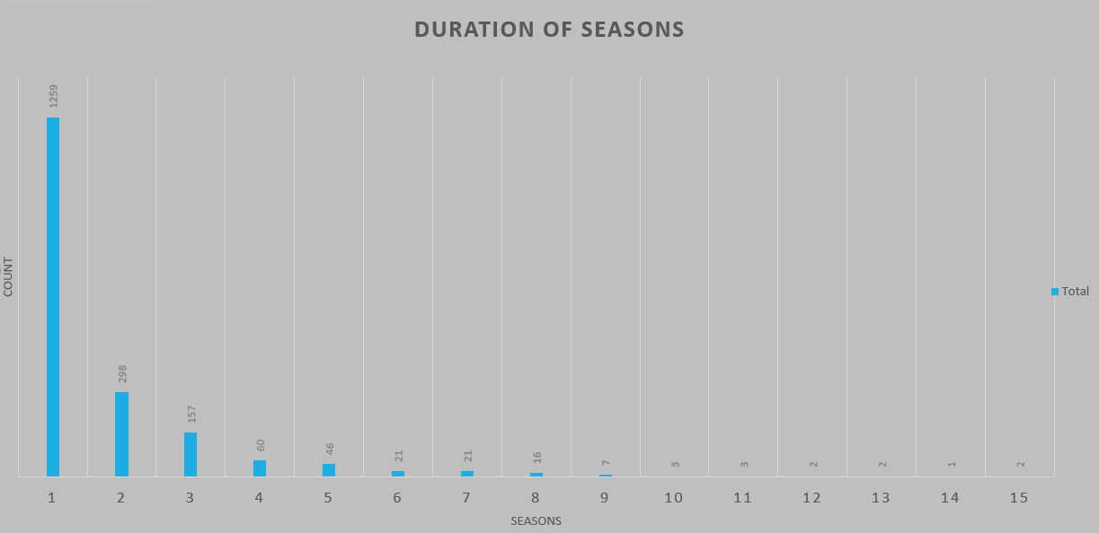
Keeping their attention
The huge majority of shows on the platform have just one season, highlighting how important new content is. 1 to 4 seasons is optimal
However, there are some long-running shows too.
Fan favourites NCIS and Grey's Anatomy both have 15 seasons available.

Slide 13
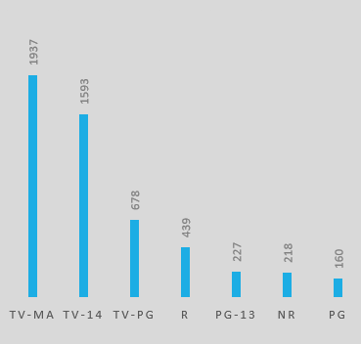
Know your audience
Netflix offers content for all ages but its focus is on adult audiences
60%
of Netflix content
is rated
mature or 14+

Slide 14
Content is key
To optimise your new service and compete with Netflix, the data shows the following key factors to success:
Key findings
Use the data to get the right mix
Feature-length content doesn't necessarily mean movies. Include stand-up and documentaries in your mix.
Think international with global content
Keep it new
Our recommendations:
Further research into data for streaming figures and viewer ratings
CS STREAMING

